Slide 1


1st General Assembly Meeting
EMPOWERING OUR PEOPLE WITH SCIENCE AND ITS LANGUAGES.
Speakers :
- Dr. Per-Edvin Persson, CEO of Heureka (Finland)
- Dr. Rana Elkaliouby, MIT Media Lab (USA)
-
Prof. Hassan Dweik, Vice President of the Al Quds Univesrsity, East Jerusalem
- Dr. Julia Taguena Parga, Universidad Nacional Autónoma de México

Slide 2
The Role of Science Centers in Knowledge Based Societies
How to build? opportunities and risks
What is the meaning of "Knowledge based society"?
-different approaches
-common goals
-exchange of experiences
How science centres can respond to the society needs and become an imbedded part of the territory?

Slide 3

Dr. Per-Edvin Persson, Director
Heureka, the Finnish Science Centre
Empowerment of people with science

Slide 4

Dr. Rana Elkaliouby
Research Scientist, Media Laboratory, Massachusetts Institute of Technology, USA
From Knowledge-based to Creative Societies - Science Centers as Creativity Incubators

Slide 5
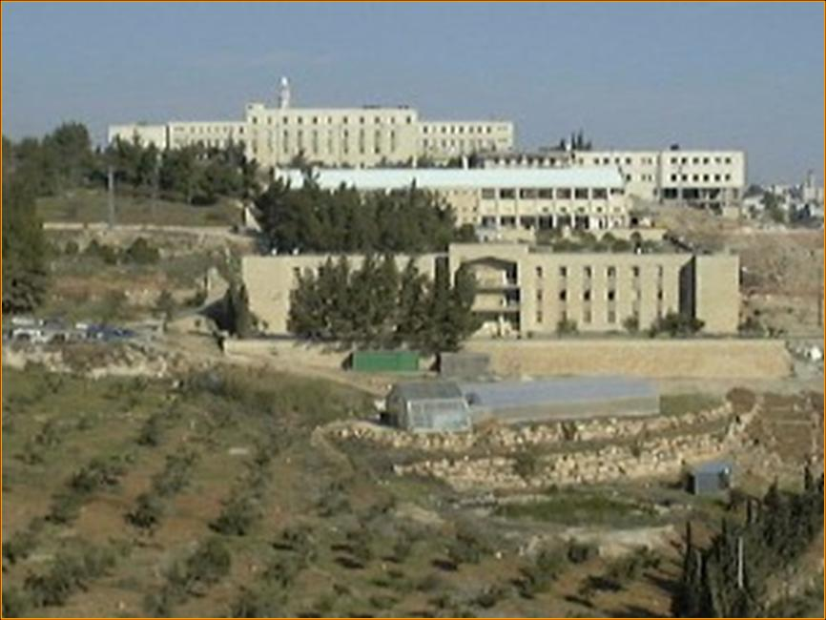
Prof Hassan Salah Dweik,
Professor of Chemistry , Director of Science Discovery Center and Mathematics Museum, Executive Vice President, AL-QUDS UNIVERSITY EAST-JERUSALEM
Networking as a Vehicle for the Creation of Science Discovery Center and Mathematics Museum at Al-Quds University in Palestine

Slide 6
Dr. Julia Tagüeña Parga
Centro de Investigación en Energía
Universidad Nacional Autónoma de México
A LATIN PERSPECTIVE

